Slide 1

Housing Price Prediction Project
Created By
Jayashri Dandare

Slide 2
Introduction

Slide 3
Problem Statement
Houses are one of the necessary need of each and every person around the globe and therefore housing and real estate market is one of the markets which is one of the major contributors in the world’s economy. It is a very large market and there are various companies working in the domain. Data science comes as a very important tool to solve problems in the domain to help the companies increase their overall revenue, profits, improving their marketing strategies and focusing on changing trends in house sales and purchases. Predictive modelling, Market mix modelling, recommendation systems are some of the machine learning techniques used for achieving the business goals for housing companies. Our problem is related to one such housing company.
A US-based housing company named Surprise Housing has decided to enter the Australian market. The company uses data analytics to purchase houses at a price below their actual values and flip them at a higher price. For the same purpose, the company has collected a data set from the sale of houses in Australia. The data is provided in the CSV file below.
The company is looking at prospective properties to buy houses to enter the market. You are required to build a model using Machine Learning in order to predict the actual value of the prospective properties and decide whether to invest in them or not.
For this company wants to know:
Which variables are important to predict the price of variable?
How do these variables describe the price of the house?

Slide 4
Understanding Problem
To understand real world problems where Machine Learning and Data Analysis can be applied to help organizations in various domains to make better decisions with the help of which they can gain profit or can be escaped from any loss which otherwise could be possible without the study of data .One of such domain is Real Estate.
Houses are one of the necessary need of each and every person around the globe and therefore housing and real estate market is one of the markets which is one of the major contributors in the world’s economy. It is a very large market and there are various companies working in the domain. Data science comes as a very important tool to solve problems in the domain to help the companies increase their overall revenue, profits, improving their marketing strategies and focusing on changing trends in house sales and purchases. Predictive modelling, Market mix modelling, recommendation systems are some of the machine learning techniques used for achieving the business goals for housing companies. Our problem is related to one such housing company.

Slide 5
Exploratory Data Analysis (EDA) Steps
Statistical summary
To check Correlation
Univatriate Analysis
Bivariate Analysis
Multivariate Analysis
Handling outliers and skewness

Slide 6
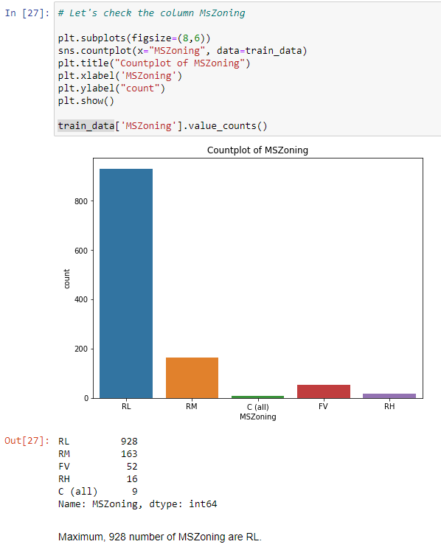
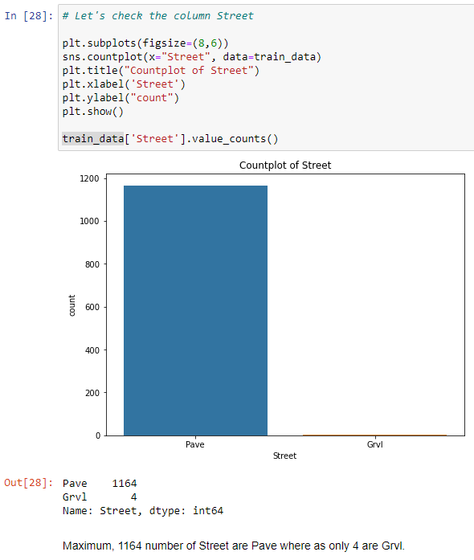
Visualizations

Slide 7
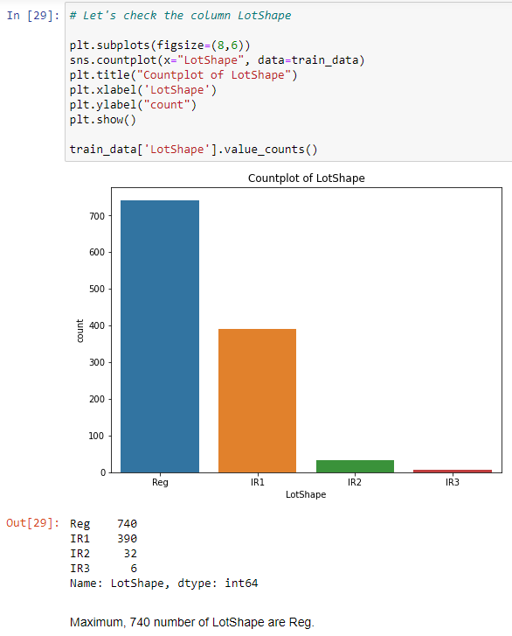
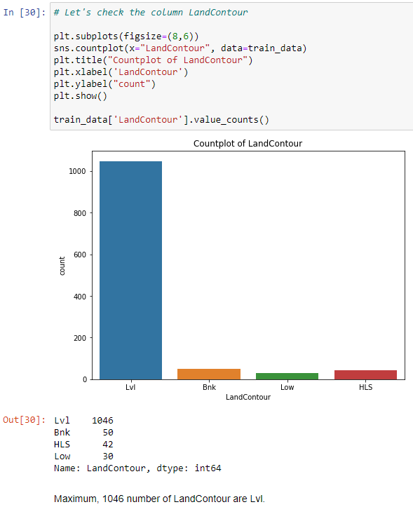
Visualizations

Slide 8
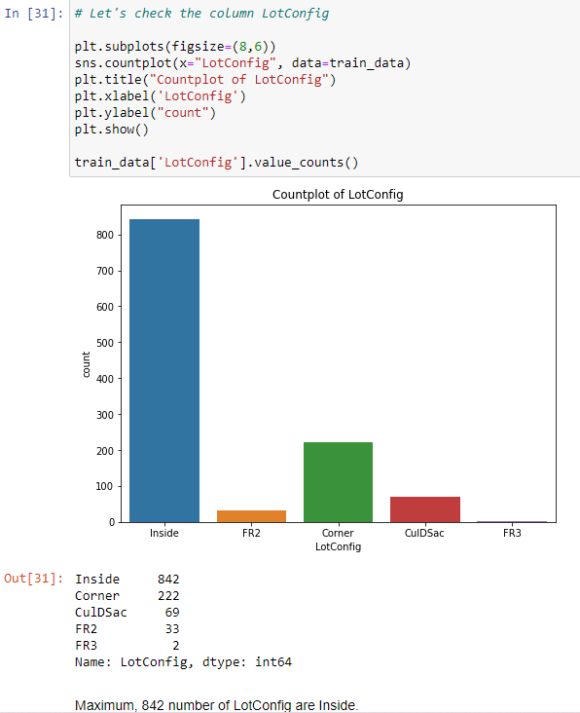
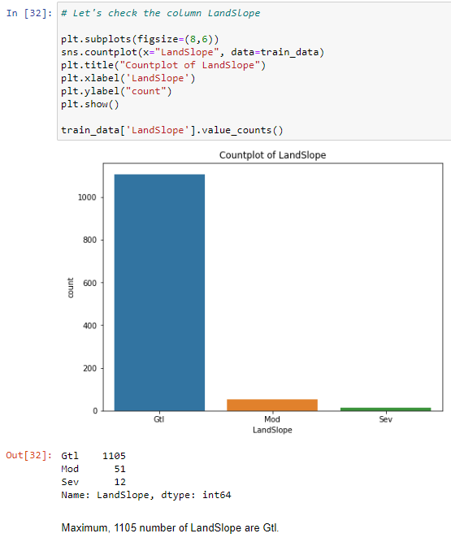
Visualizations

Slide 9
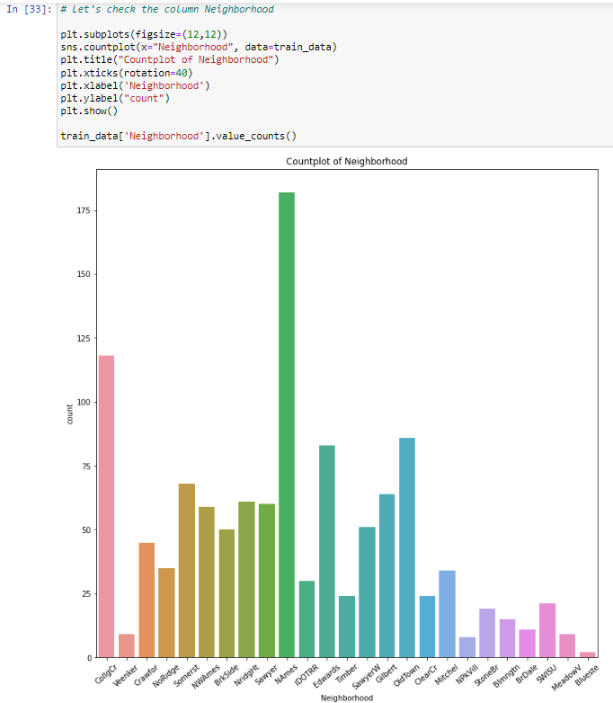
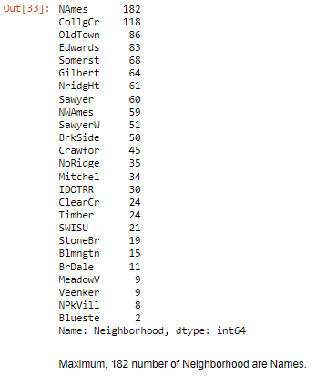
Visualizations

Slide 10
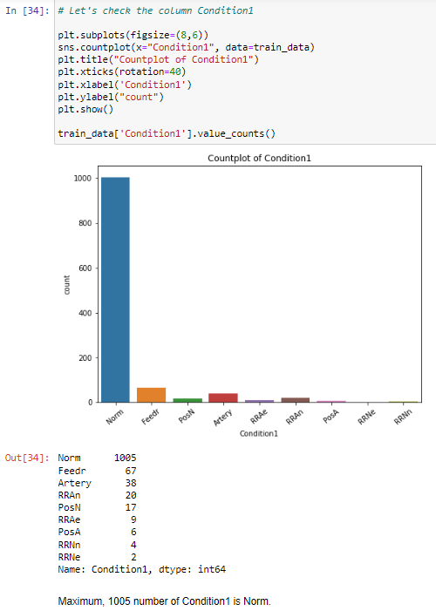
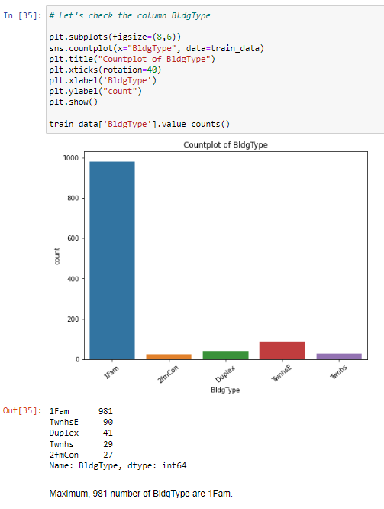
Visualizations

Slide 11
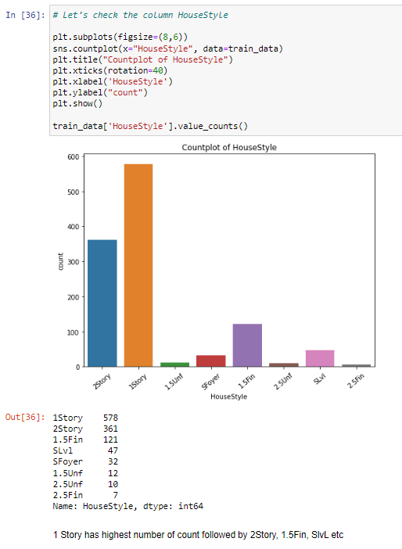
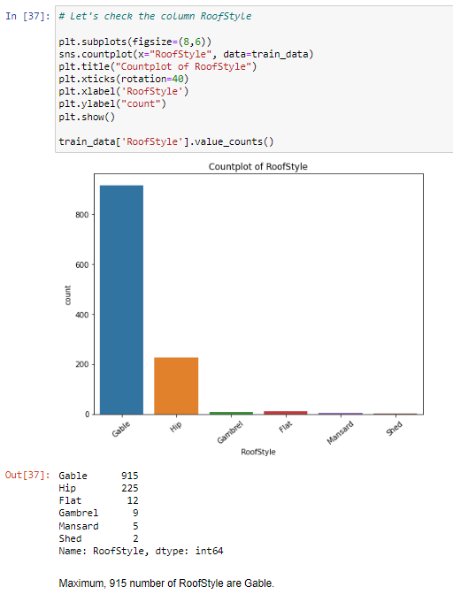
Visualizations

Slide 12
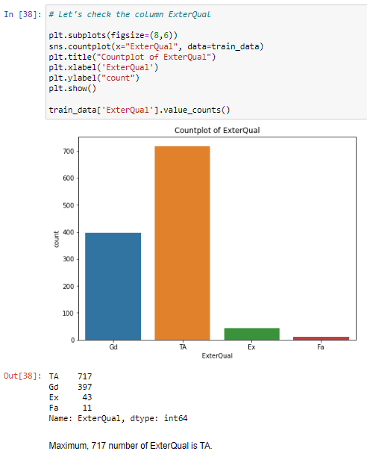
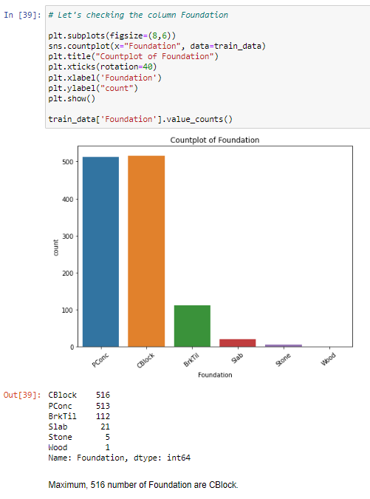
Visualizations

Slide 13
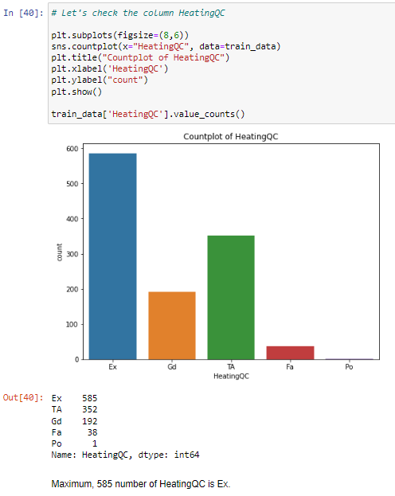
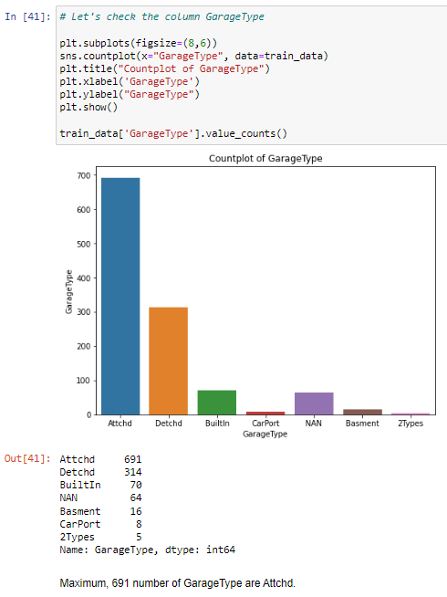
Visualizations

Slide 14
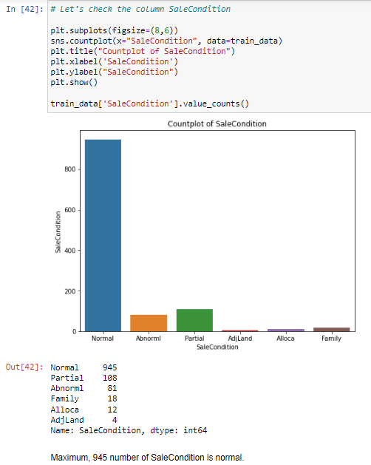
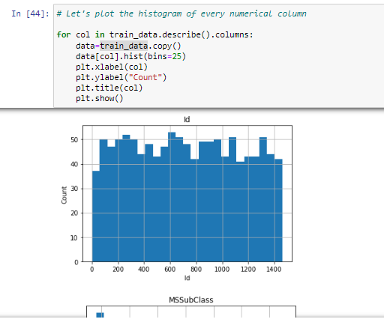
Visualizations

Slide 15
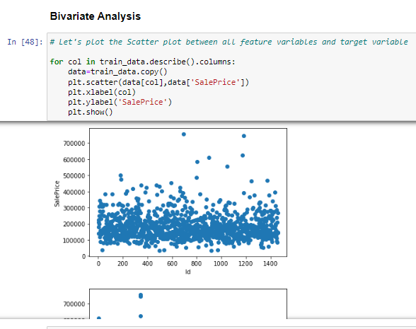
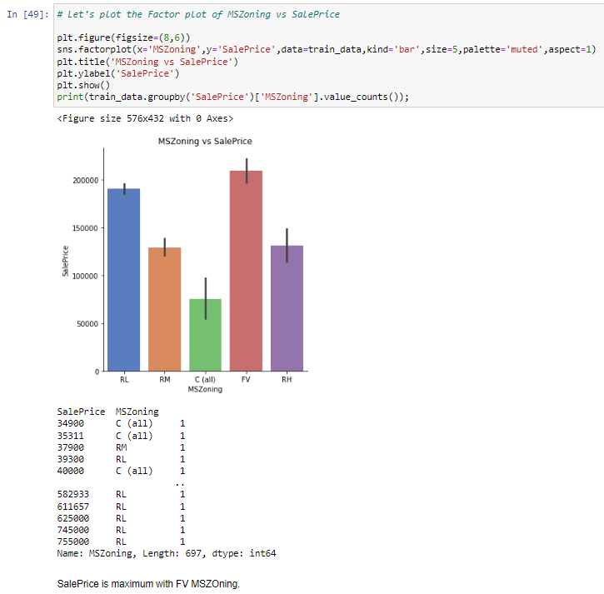
Visualizations

Slide 16
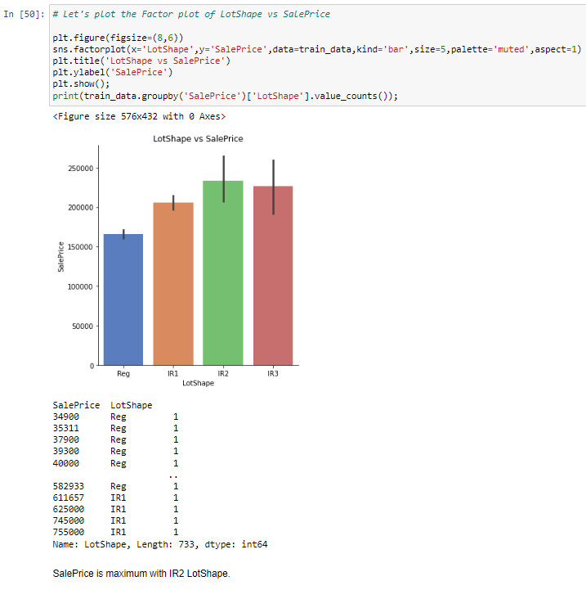
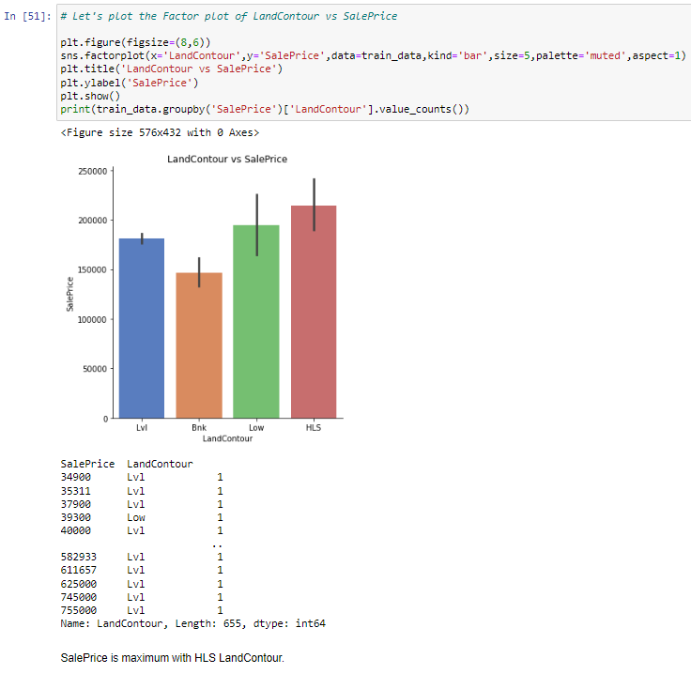
Visualizations

Slide 17
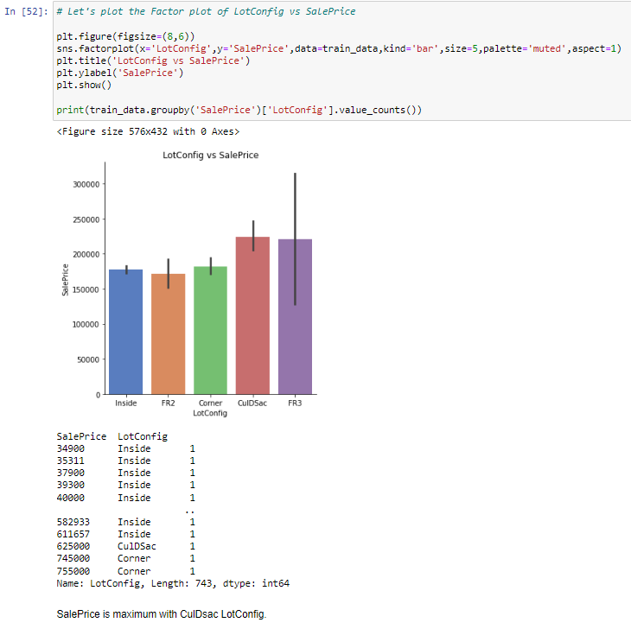
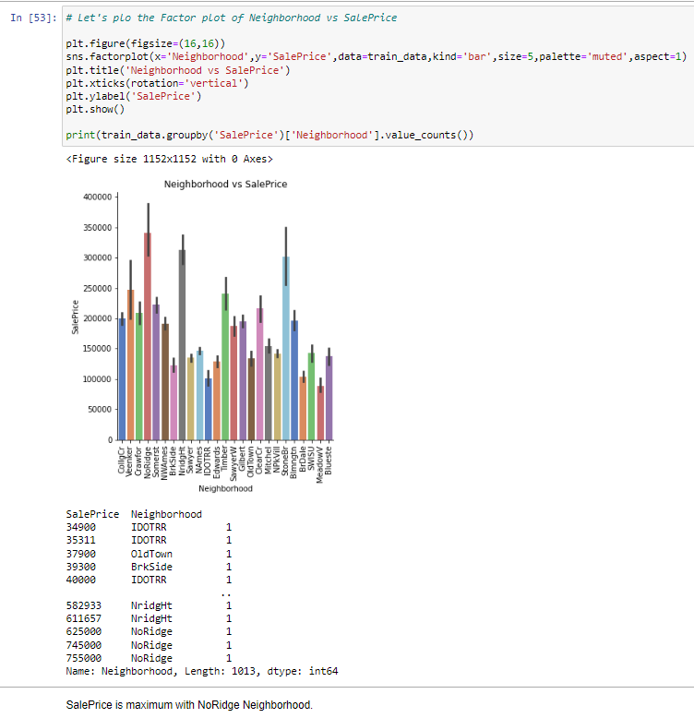
Visualizations

Slide 18
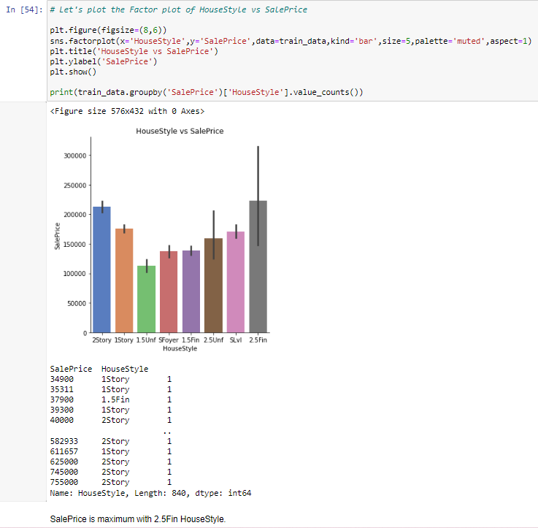
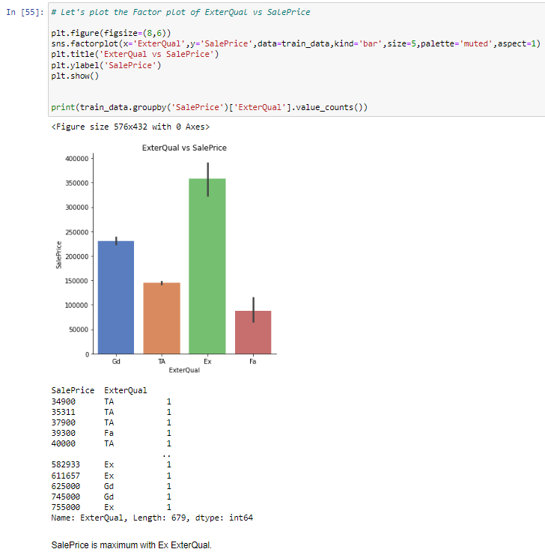
Visualizations

Slide 19
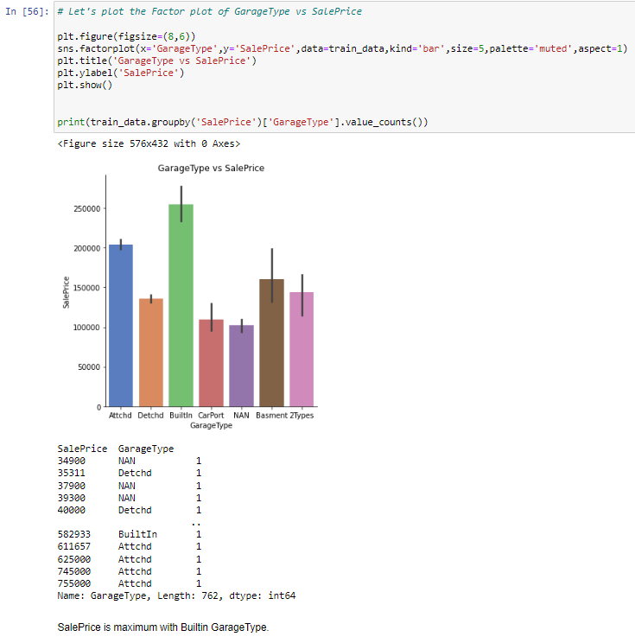
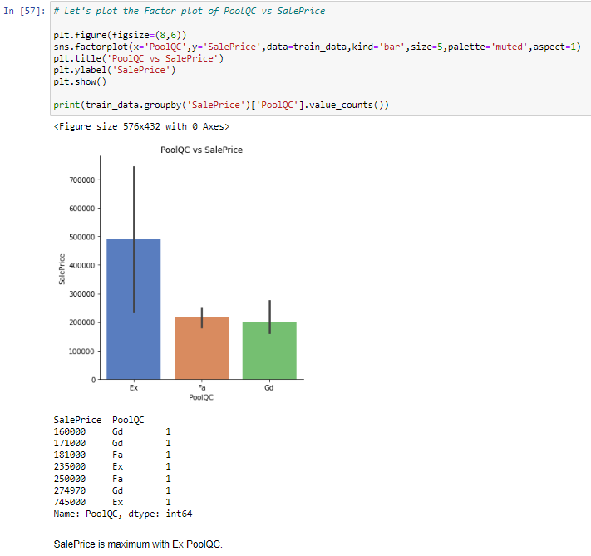
Visualizations

Slide 20
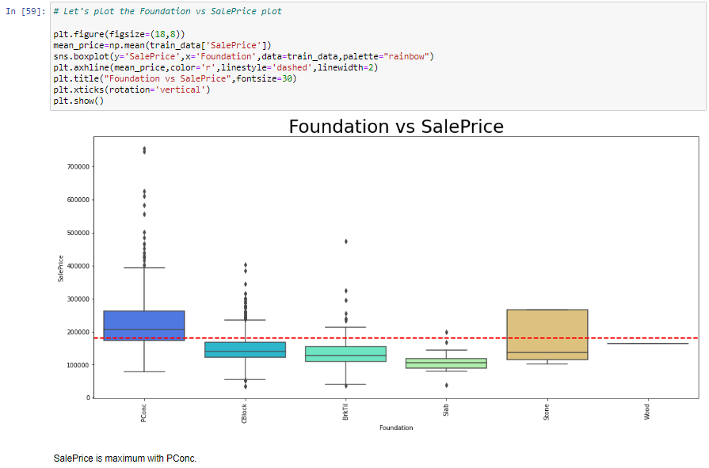
Visualizations

Slide 21
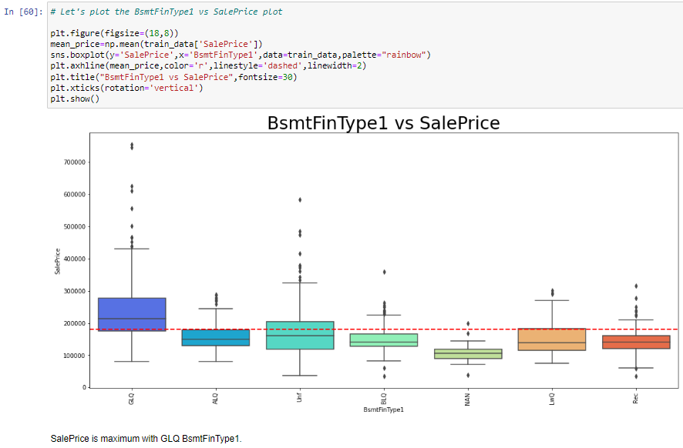
Visualizations

Slide 22
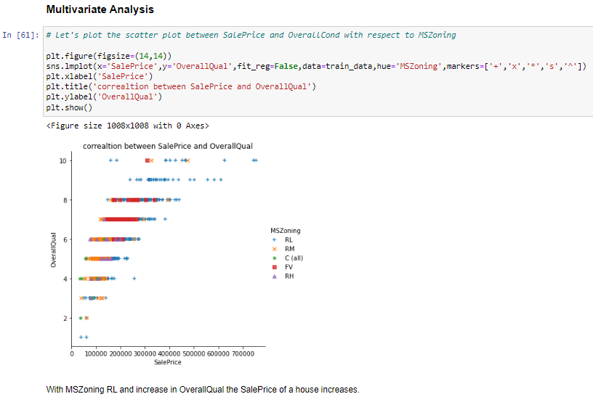
Visualizations

Slide 23
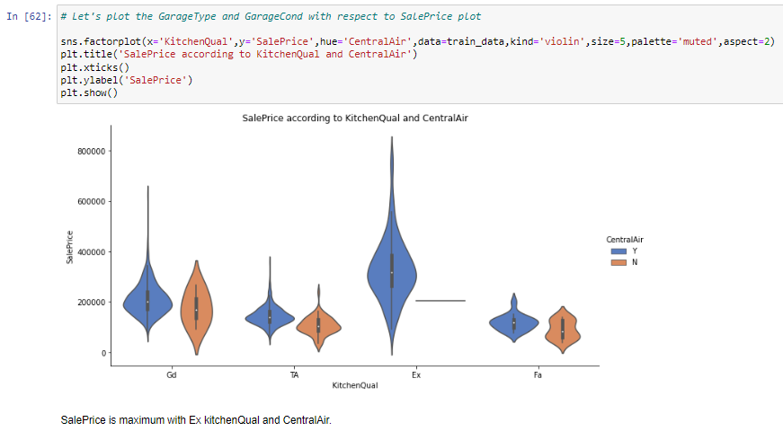
Visualizations

Slide 24
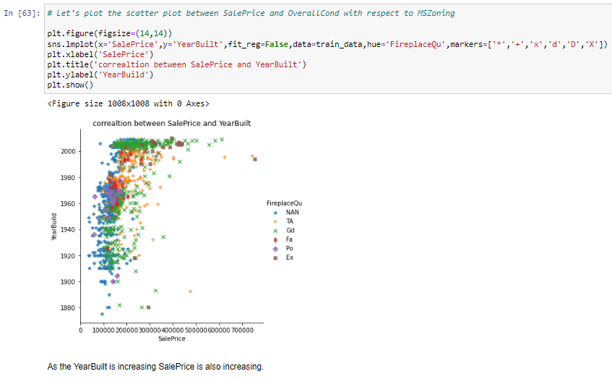
Visualizations

Slide 25
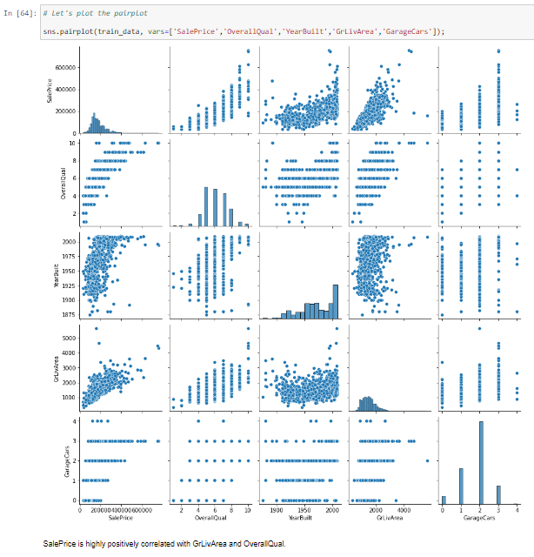
Visualizations

Slide 26
SET OF ASSUMPTIONS RELATED TO THE PROBLEM UNDER CONSIDERATION
By looking into the target variable label we assumed that it was a Regression type of problem.
We observed multicollinearity in between columns so we assumed that we will be using Principal Component Analysis (PCA).
We also observed that only one single unique value was present in Utilities column so we assumed that we will be dropping this columns.

Slide 27
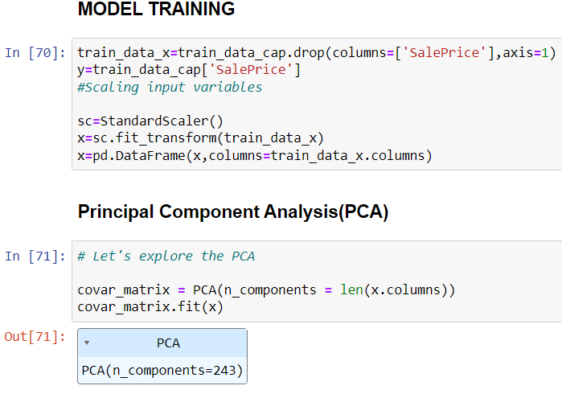
Model dashboard

Slide 28
Interpretation of the Results:
From the visualization we interpreted that the target variable SalePrice was highly positively correlated with the columns GrLivArea, YearBuilt, OverallQual, GarageCars, GarageArea.
From the preprocessing we interpreted that data was improper scaled

Slide 29
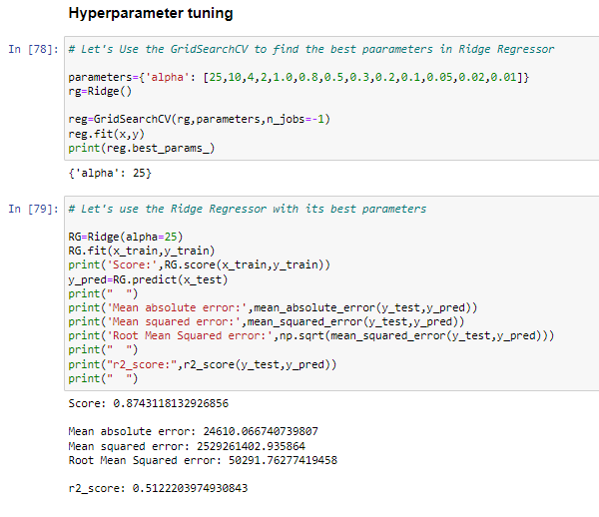
Visualizations
From the modeling we interpreted that after hyperparameter tuning Ridge Regressor works best giving 87% score.

Slide 30
conclusion

Slide 31
KEY FINDINGS AND CONCLUSIONS OF THE STUDY
In this project we have tried to show how the house prices vary and what are the factors related to the changing of house prices. The best(minimum) RMSE score was achieved using the best parameters of Ridge Regressor through GridSearchCV though Lasso Regressor model performed well too.

Slide 32
LEARNING OUTCOMES OF THE STUDY IN RESPECT OF DATA SCIENCE
This project has demonstrated the importance of sampling effectively, modelling and predicting data.
Through different powerful tools of visualization we were able to analyse and interpret different hidden insights about the data.
Through data cleaning we were able to remove unnecessary columns and outliers from our dataset due to which our model would have suffered from overfitting or underfitting.

Slide 33
LEARNING OUTCOMES OF THE STUDY IN RESPECT OF DATA SCIENCE
The few challenges while working on this project where:-
Improper scaling
Too many features
Missing values
Skewed data due to outliers
The data was improper scaled so we scaled it to a single scale using sklearns’s package StandardScaler.
There were too many(256) features present in the data so we applied Principal Component Analysis(PCA) and found out the Eigenvalues and on the basis of number of nodes we were able able to reduce our features upto 90 columns.

Slide 34
LEARNING OUTCOMES OF THE STUDY IN RESPECT OF DATA SCIENCE
There were lot of missing values present in different columns which we imputed on the basis of our understanding.
The columns were skewed due to presence of outliers which we handled through Winsorization Technique.

Slide 35
conclusion
In this project we have tried to show how the house prices vary and what are the factors related to the changing of house prices.
The best(minimum) RMSE score was achieved using the best parameters of Ridge Regressor through GridSearchCV though Lasso Regressor model performed well too.
While we couldn’t reach out goal of RMSE in house price prediction without letting the model to overfit, we did end up creating a system that can with enough time and data get very close to that goal.

Slide 36
Thank you

